Slide 1

09th October, 2018
Mentor:
Dr Singara Singh
Associate Professor
CSED, TIET
Team Members:
Akshay Sharma | 101683035 | COE 1
Abhishek Sharma | 101503008 | COE 1

Slide 2
Project overview
Pianos are large instruments that need to be carried in a large bag and are prone to damage.
Portable virtual piano that just uses semi-transparent plastic sheet.
Virtual Pianos will be economical and will help young children to get a feel for music and will act as a stepping stone for some of the world’s greatest artists.
Approved Objectives
Assigning the respective tones of piano to the corresponding segments of Virtual Piano made using a semi-transparent plastic sheet.
Real time motion detection of fingers using a camera linked with Raspberry pi.
To play the tone assigned to a segment on detection of finger on that particular segment.

Slide 3
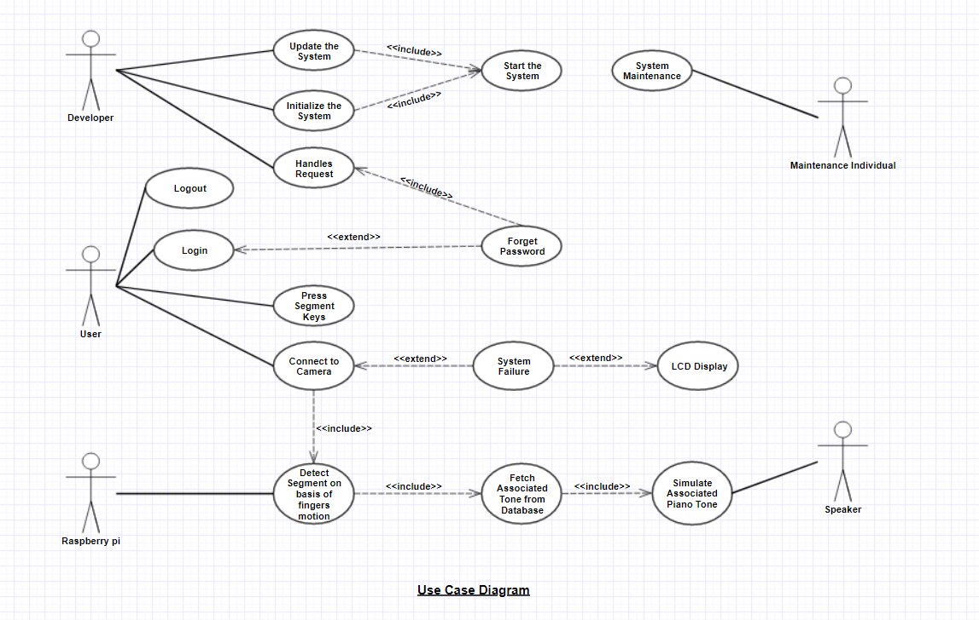
Use-Case Diagram

Slide 4
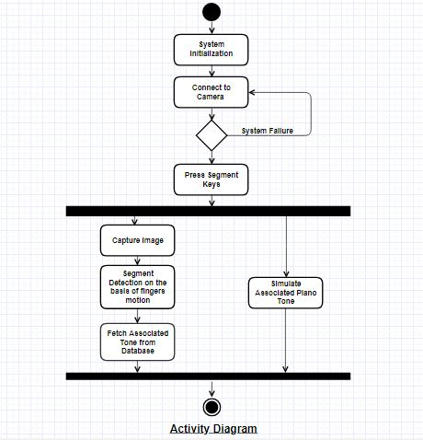
Activity Diagram

Slide 5
Tools Used
Raspberry Pi - The Raspberry Pi is a low cost, credit-card sized computer that plugs into a computer monitor or TV, and uses a standard keyboard and mouse.
Camera – To capture the real time motion of fingers.
Speaker – To simulate the piano tones.
Transparent Sheet – A virtual keyboard for user to press the segment key.
LCD Display - To display working status of the piano.
The best team is where
the best leader be

Slide 6
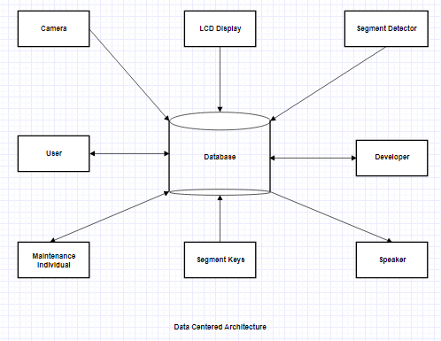
Data Centered Architecture

Slide 7
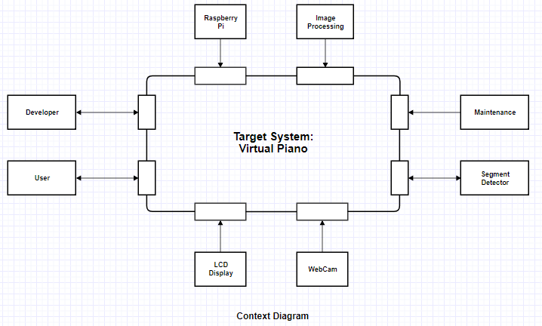
Context Diagram

Slide 8
Cost Analysis
Raspberry PI: | ₹ 3,649.00 | Digital Multimeter: | ₹ 250.00
PCB Board: | ₹ 185.00 | LCD Display: | ₹ 1410.00
SD Card: | ₹ 599.00 | Wire stripper & cutter: | ₹ 58.00
Speaker: | ₹ 200.00 | Miscellaneous: | ₹ 399.00
Webcam: | ₹ 850.00
Soldering Iron: | ₹ 299.00
Total | ₹ 7899.00

Slide 9
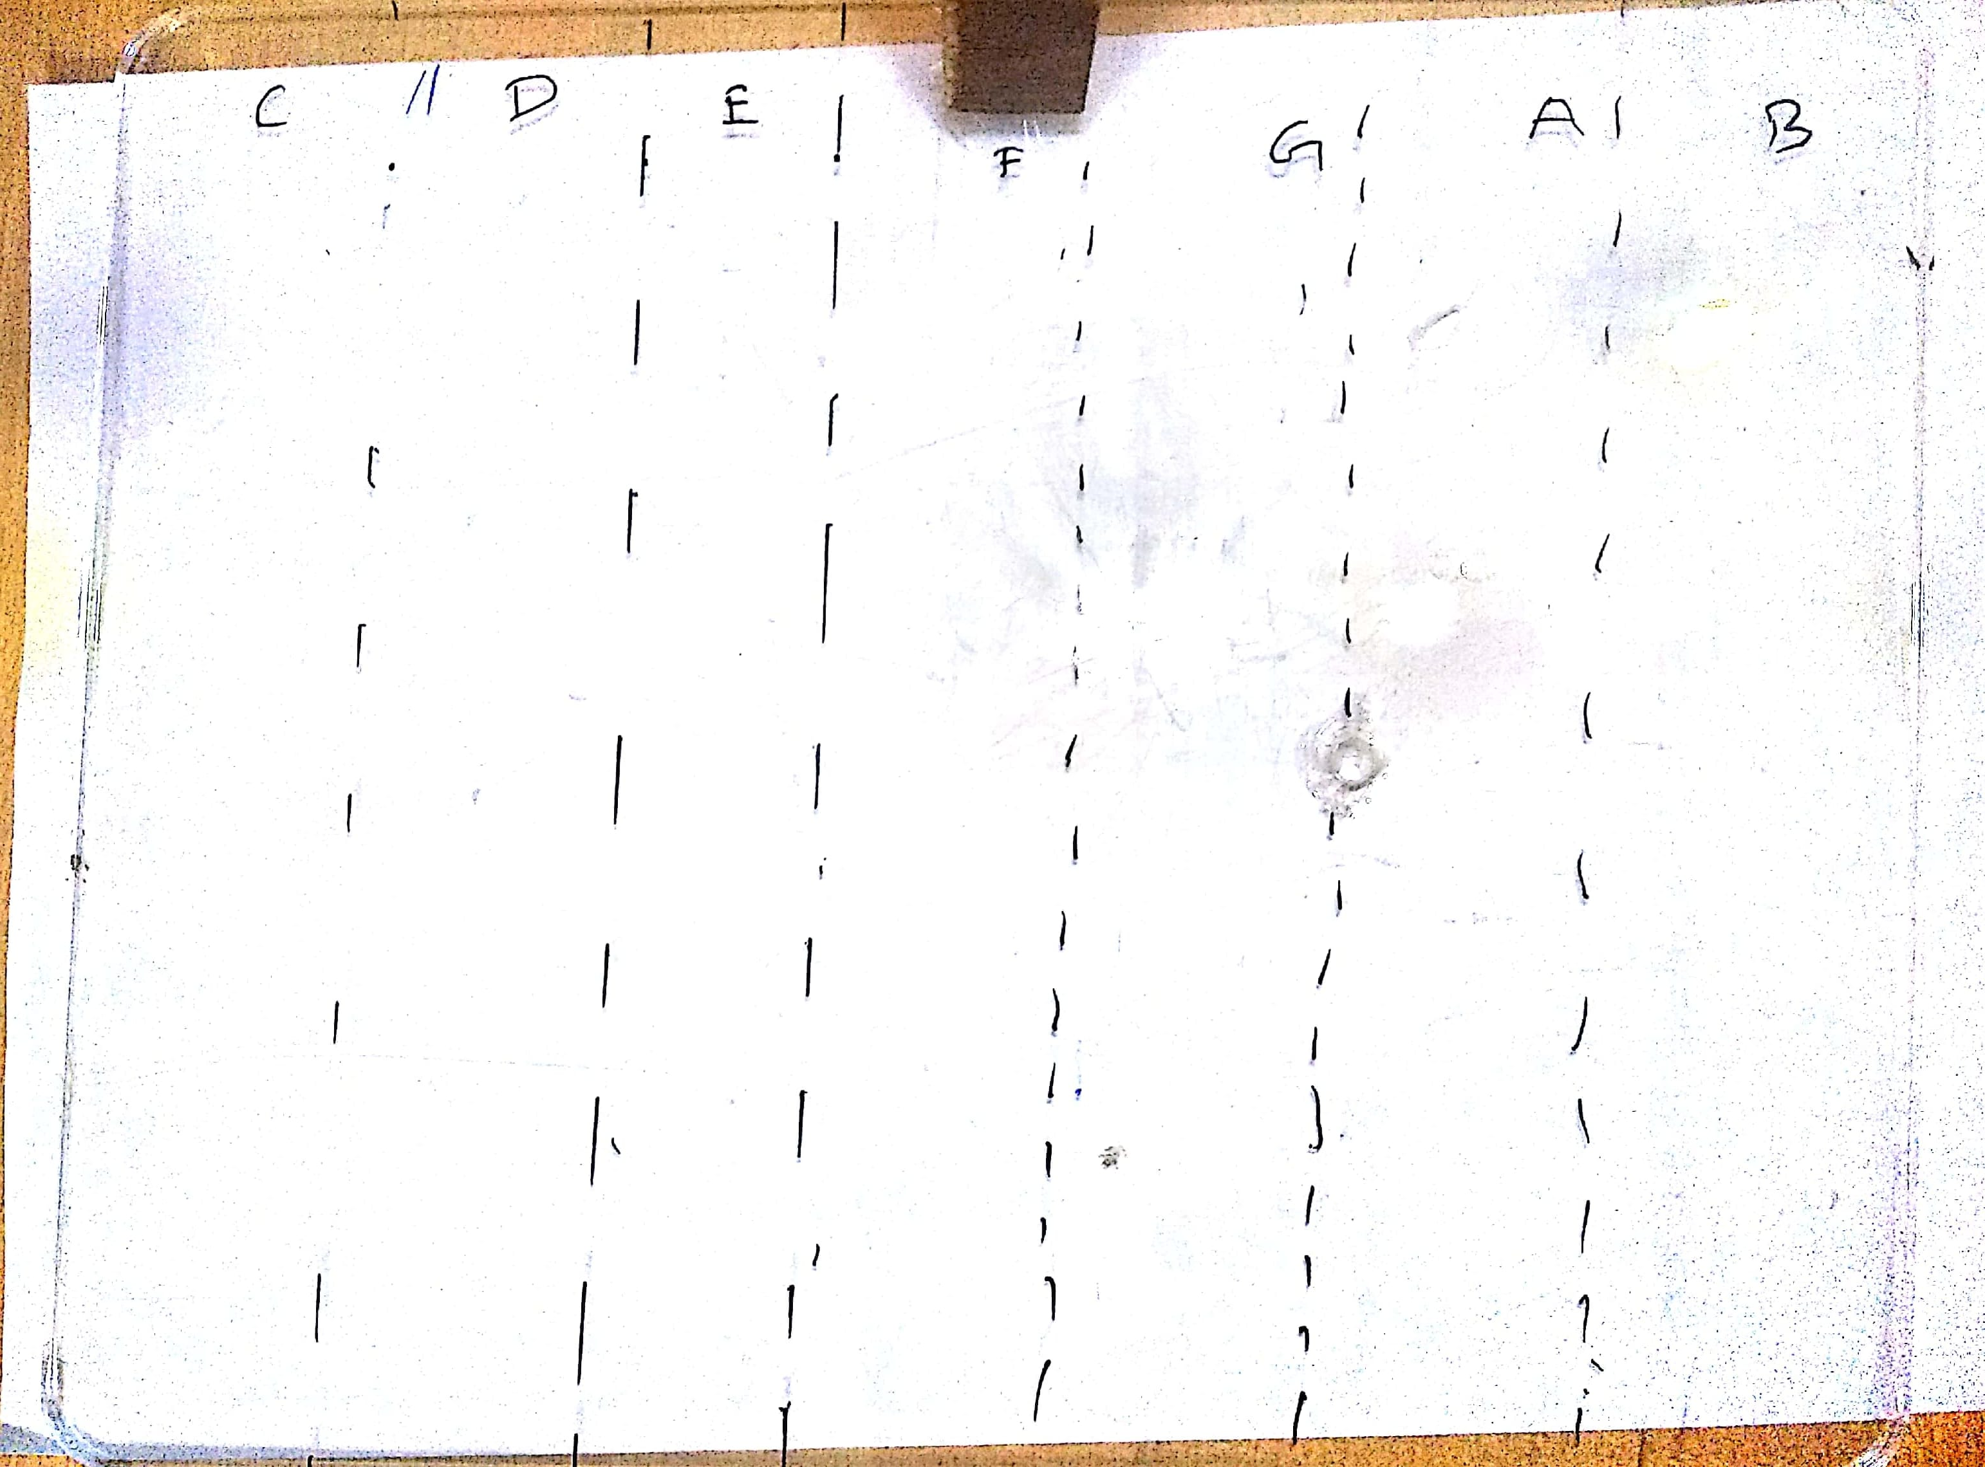
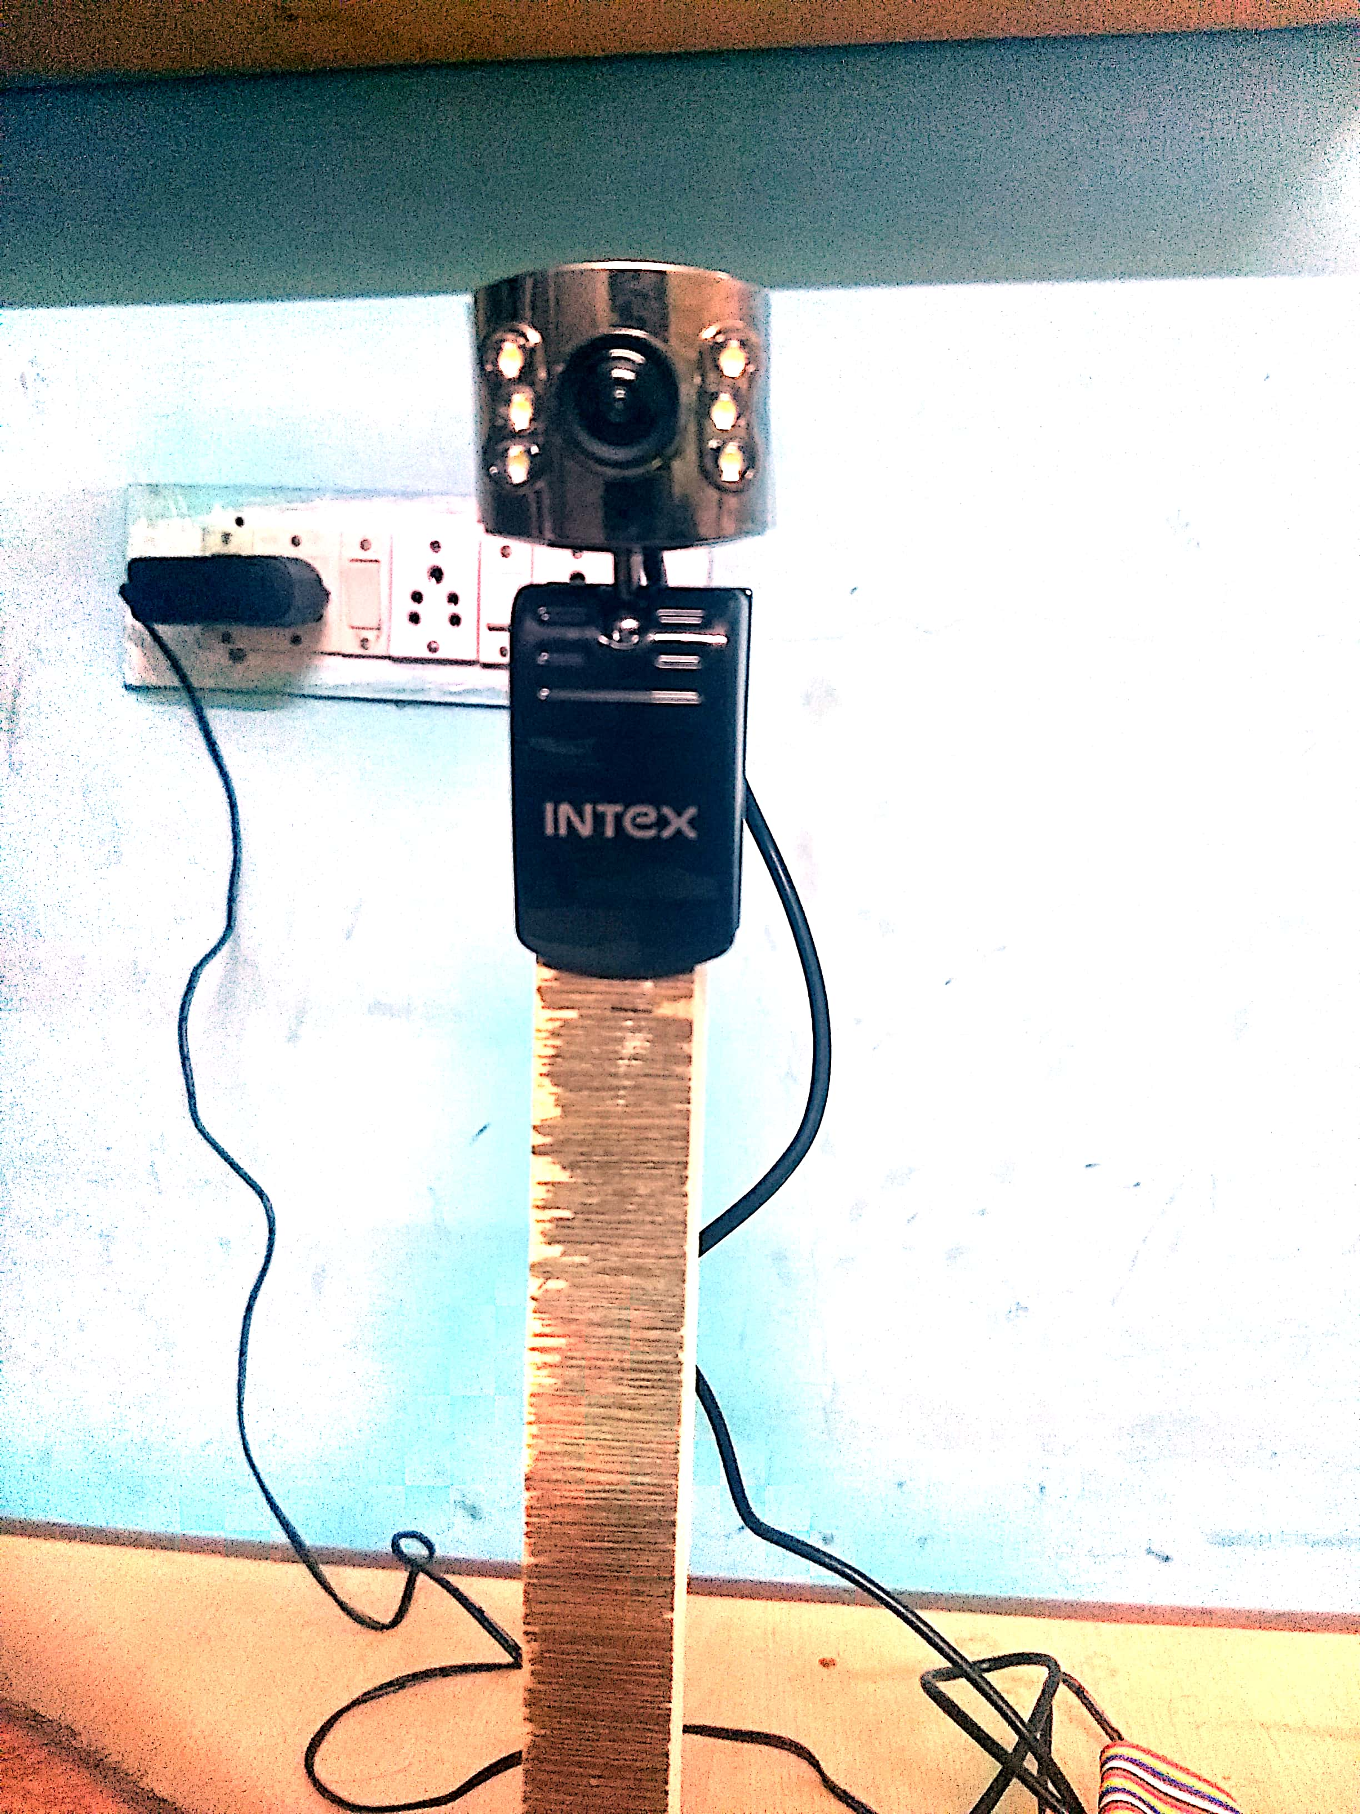
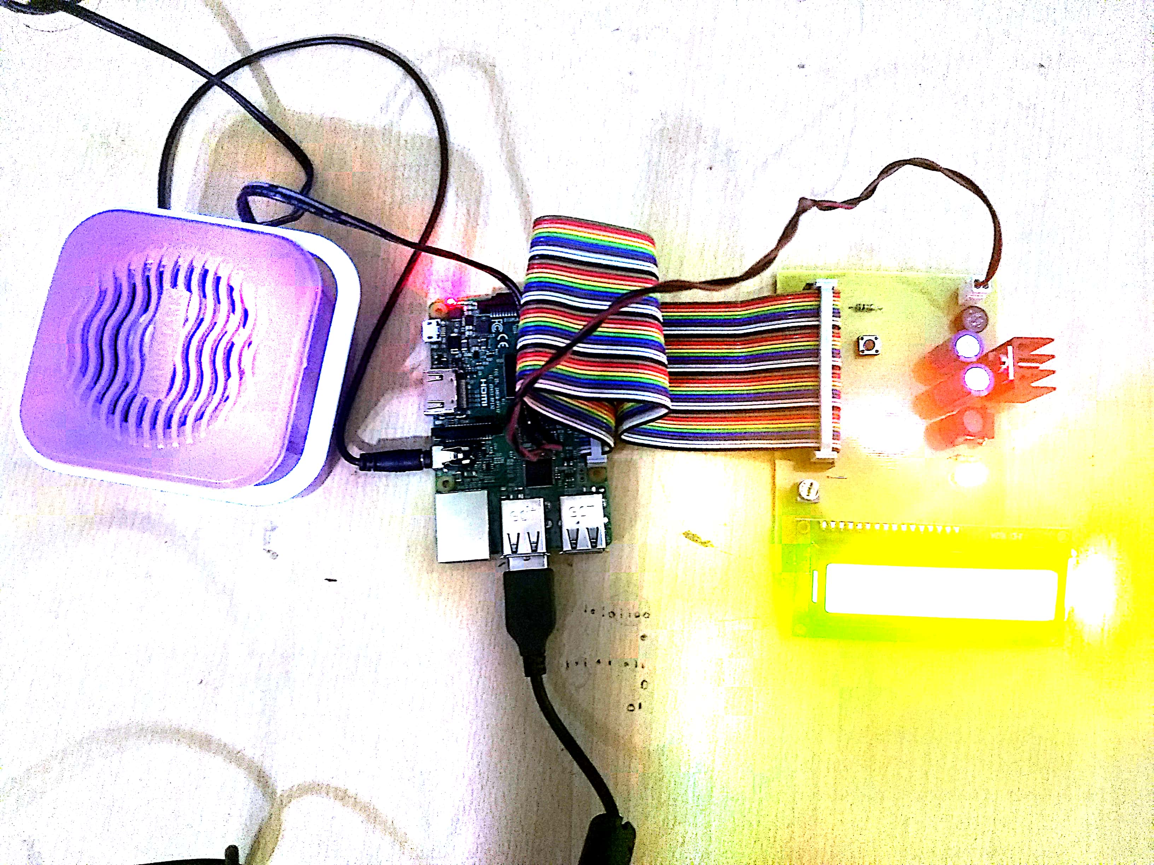
Outcomes

Slide 10
Project Execution Completed
1.
4.
3.
2.
System Design
Hardware
Assembled
Implemented
Real Time sensing
Simulate piano tones
Created the architecture for our project
Procured & assembled hardware based on system design specification
Finalized the implementation of real time sensing algorithm
Simulate associated piano tone based on the detected segment

Slide 11
Thank
You

